Slide 1

Execution of the OAD: convert2pyramidal_OMETIFF.py
Praseedha Aniyath
Microsoft Automation and Image Analysis Trainee
2020-11-11

Slide 2
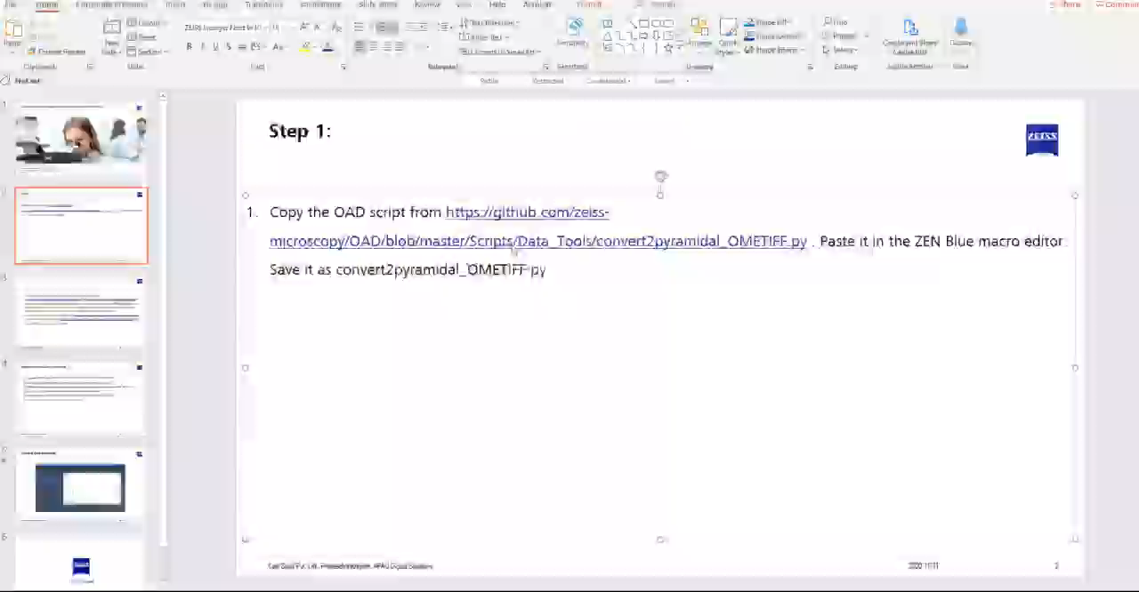
Step 1:Copy the OAD script from https://github.com/zeiss-microscopy/OAD/blob/master/Scripts/Data_Tools/convert2pyramidal_OMETIFF.py . Paste it in the ZEN Blue macro editor. Save it as convert2pyramidal_OMETIFF.py

Slide 3
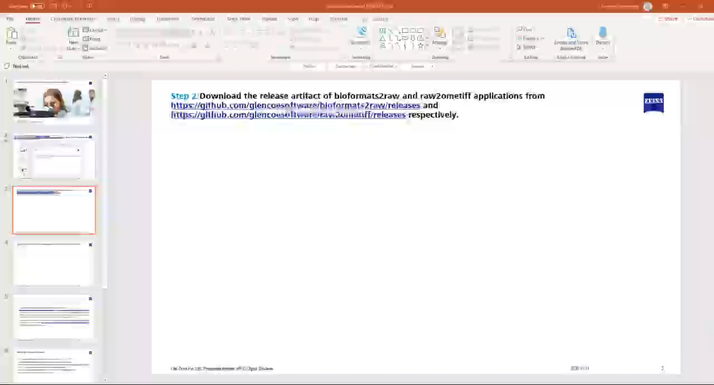
Step 2:Download the release artifact of bioformats2raw and raw2ometiff applications from https://github.com/glencoesoftware/bioformats2raw/releases and https://github.com/glencoesoftware/raw2ometiff/releases respectively.

Slide 4
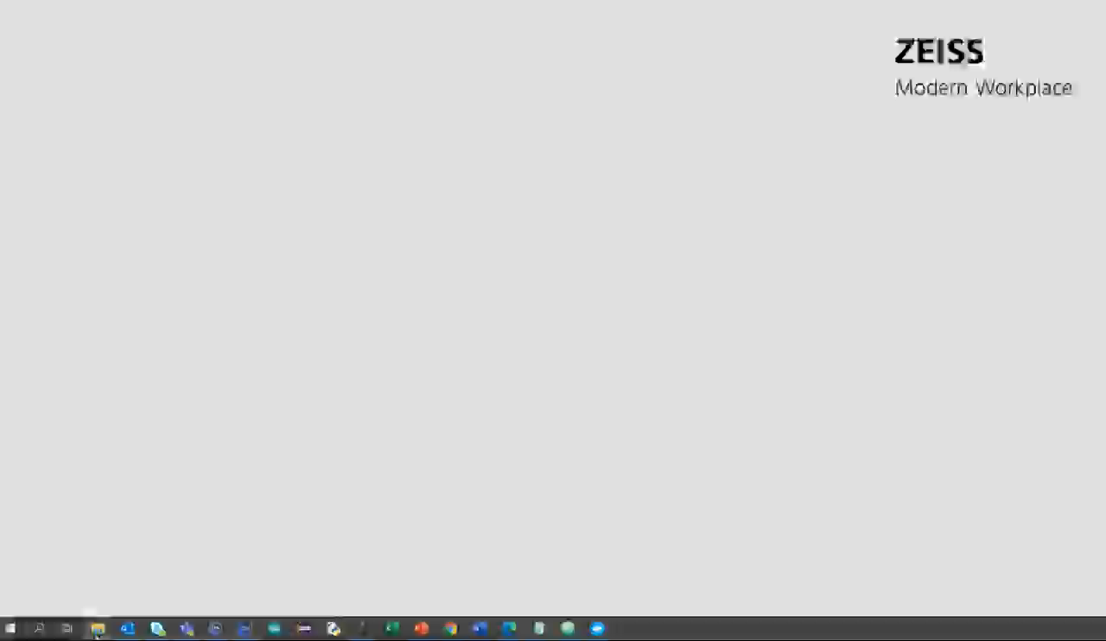
Step 3: Extract the two folders from the downloaded zip files (bioformats2raw-0.2.6.zip and raw2ometiff-0.2.8.zip) using any archive programs (e.g. WinZip, 7-Zip, WinRar)

Slide 5
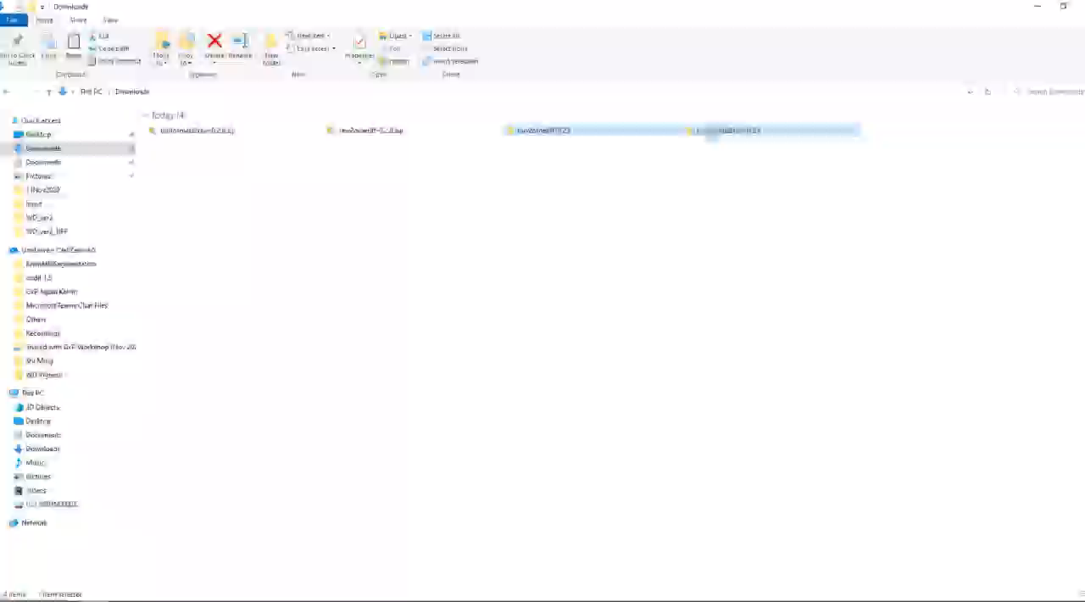
Step 4: Copy the extracted folders to say, C:/OAD/Input (or any other user-directory). Please keep note of the fact that the Java executables (bioformat2raw and raw2ometiff tools) requires a directory path with no spaces, while selecting the directory to store the folders. Otherwise, it may throw up an error regarding the same.

Slide 6
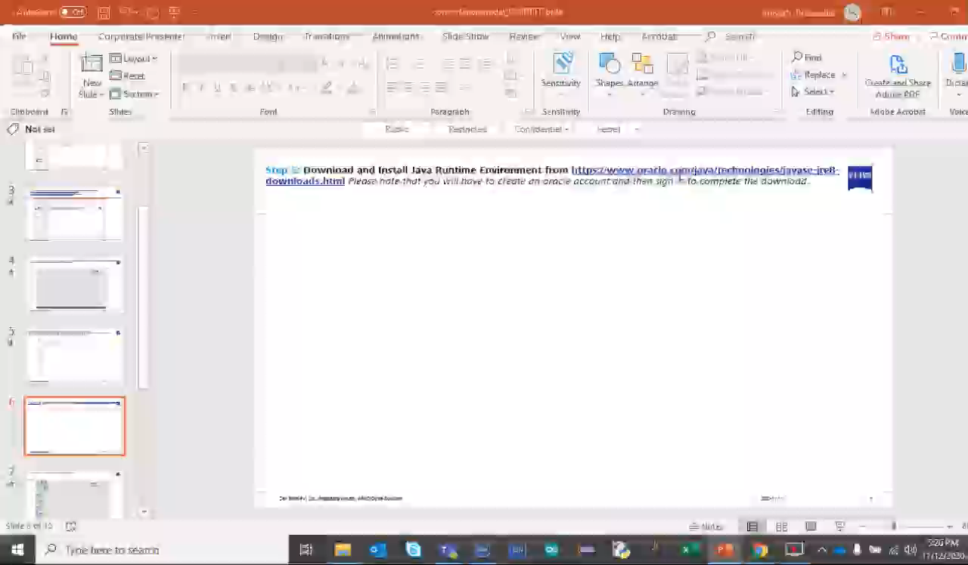
Step 5: Download and Install Java Runtime Environment from https://www.oracle.com/java/technologies/javase-jre8-downloads.html Please note that you will have to create an oracle account and then sign in to complete the download.

Slide 7
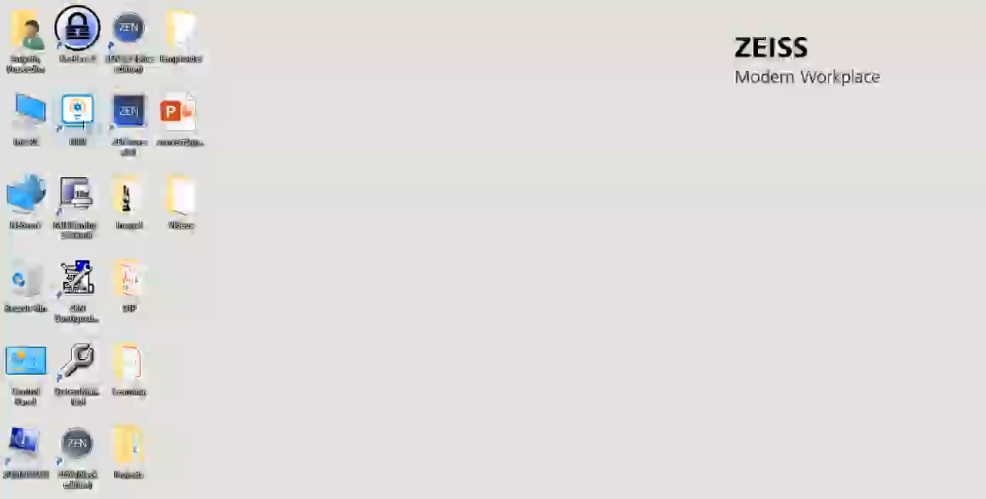
Step 6: Set JAVA_HOME as a system environment variable.

Slide 8
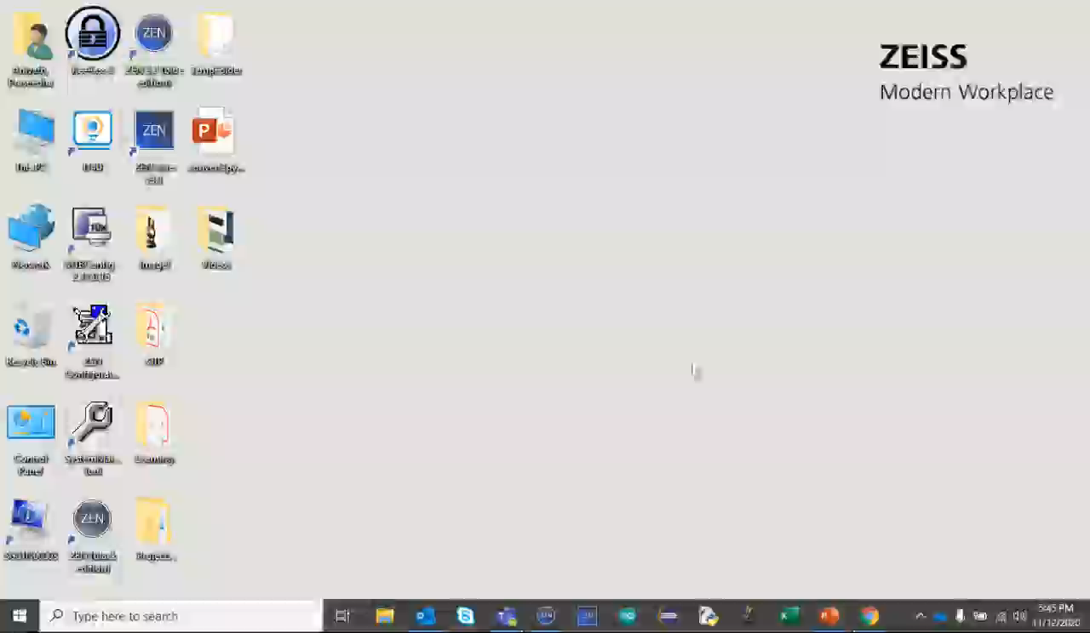
Step 7: Unzip opencv-3.4.2-1.jar using archive applications like WinRAR 7-Zip, or WinZIP from C:/OAD/Input/bioformats2raw-0.2.6/lib. Copy the file opencv_java342.dll from C:/OAD/Input/bioformats2raw-0.2.6/lib/opencv-3.4.2-1/nu/pattern/opencv/window/x86_64 (for 64-bit system) or from C:/OAD/Input/bioformats2raw-0.2.6/lib/opencv-3.4.2-1/nu/pattern/opencv/windows/x86_32 (for 32-bit system) into C:/Window/System32

Slide 9
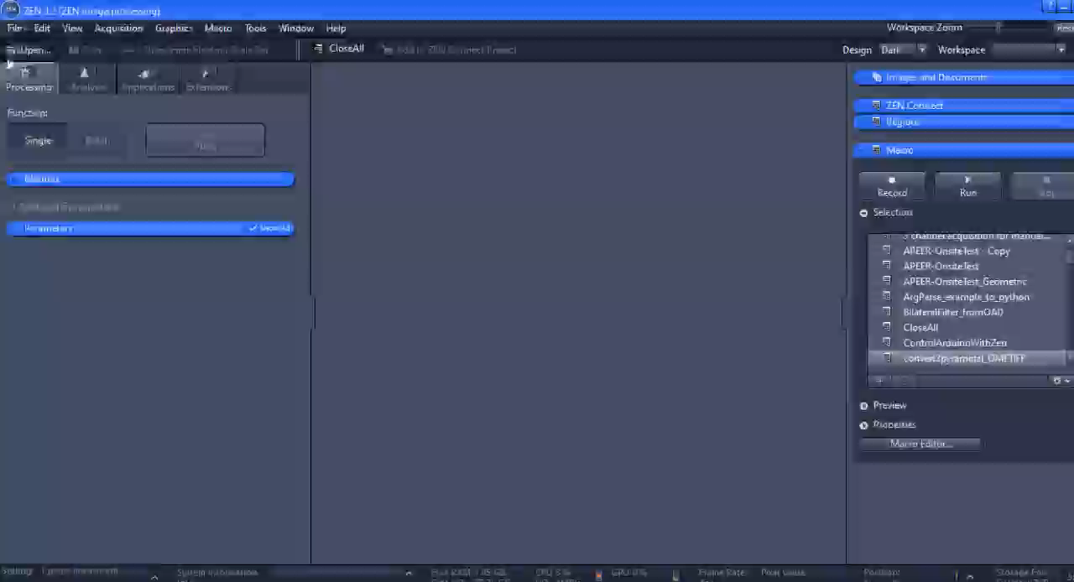
Step 8: Now, load the input image and run the OAD script from the macro-editor in ZEN Blue. A GUI will pop-up where the user can define the locations to the bioformats (C:/OAD/Input/bioformats2raw-0.2.6/bin) and raw2ometiff (C:/OAD/Input/raw2ometiff-0.2.8/bin) tools. The user can also select the input image from ZEN active document, type of compression (Raw/LZW) and number of pyramid levels in the output image. The output pyramidal ome-tiff will be saved in the same folder as the input folder.

